Slide 1
Summary of RMC modeling for Yb₂Ti_{2-2x}Sn_{2x}O₇ neutron total scattering data
Yuanpeng Zhang
Neutron Scattering Division
Dec-14-2022

Slide 2
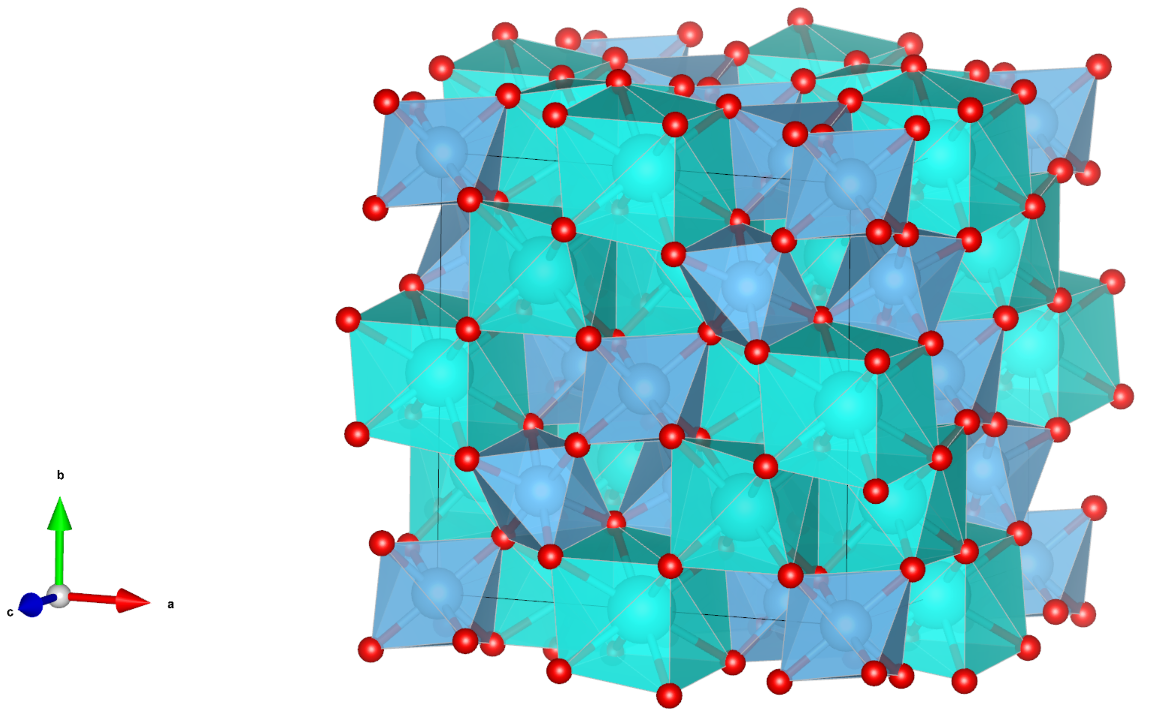
b
a
c

Slide 3
Unit cell expanded to 10x10x10 supercell and symmetry constraint removed.
Modeling were driven purely by experimental data.
Conventional metropolis Monte Carlo routine used.
Bragg data not included due to the complexity with average structure. Thus, we only focus on the local scale correlation in real space.
Both the reciprocal and real space data were included for the model refinement and the weight for each dataset was adjusted on-the-fly in an automatic manner.
For doped sample, Ti atoms were replaced with Sn in the expanded supercell in a random manner according to the stoichiometry.
On average, ~100 moves/atom were generated, among which ~20 moves/atom were accepted.

Slide 4
Total scattering data fitting

Slide 5
0p0

Slide 6
0p2

Slide 7
0p5

Slide 8
0p8

Slide 9
1p0

Slide 10
Overall, the fitting quality is reasonable in both spaces.

Slide 11
Partial PDFs

Slide 12
0p0

Slide 13
0p2

Slide 14
0p5

Slide 15
0p8

Slide 16
1p0

Slide 17
ADPs

Slide 19
No obvious anisotropy was observed in all samples

Slide 20
Triplets bond angle distribution

Slide 21
Ti

Slide 22
Sn

Slide 23
Ti & Sn

Slide 24
As the doping level increases, the distortion of the local TiO6 octahedrons increases.
Meanwhile, the relative orientation in between those corner sharing TiO6 octahedrons is distorted as well.
The Yb pyrochlore sublattice is well kept.
Distortion of the local tetrahedral environment formed by Ti(Sn) and Yb is enhanced.
The Sn-only involved angles do not show that obvious change as compared to those Ti-only involved angles.

Slide 25
Consistence with other results?
Multiple RMC runs to check self-consistenc

